Slide 1
DOWNSTREAM PROCESSING
BIOPROCESS TECHNOLOGY

Slide 2
Culture broth
Extracellular
Intracellular
Cell disruption
Mechanical
Chemical
Enzymatic
Extraction
Filtration
Filtration, Centrifugation, Extraction, Sedimentation
Concentration
Precipitation, Ultrafiltration
Purification
Chromatography
Formulation
Freeze drying, Spray drying
Final Product

Slide 3
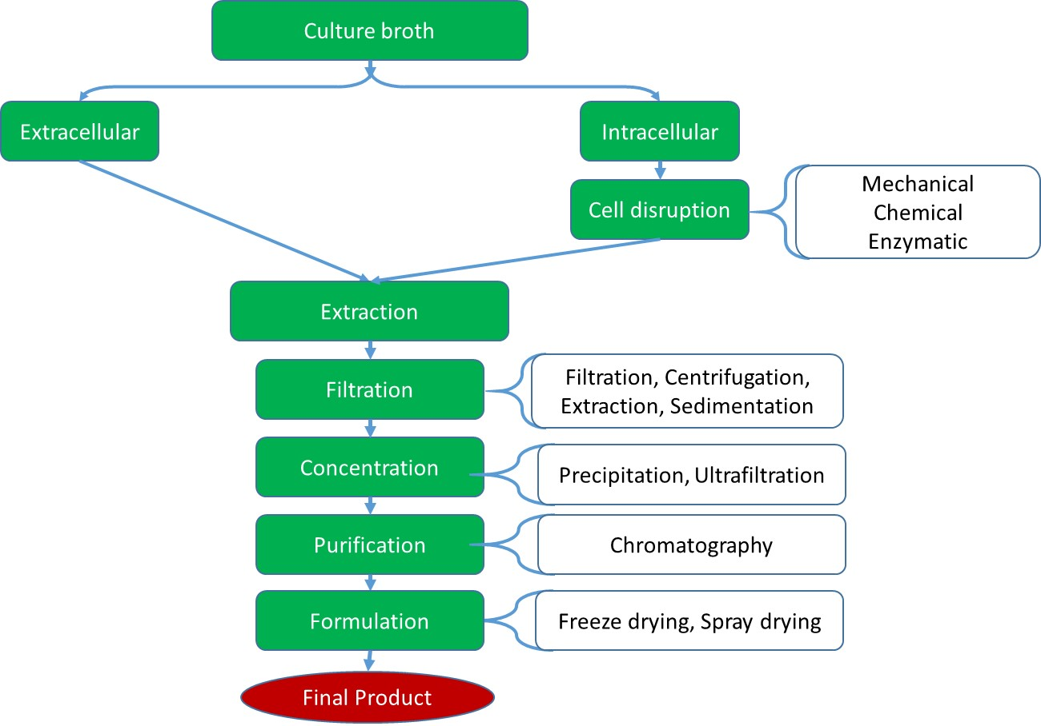
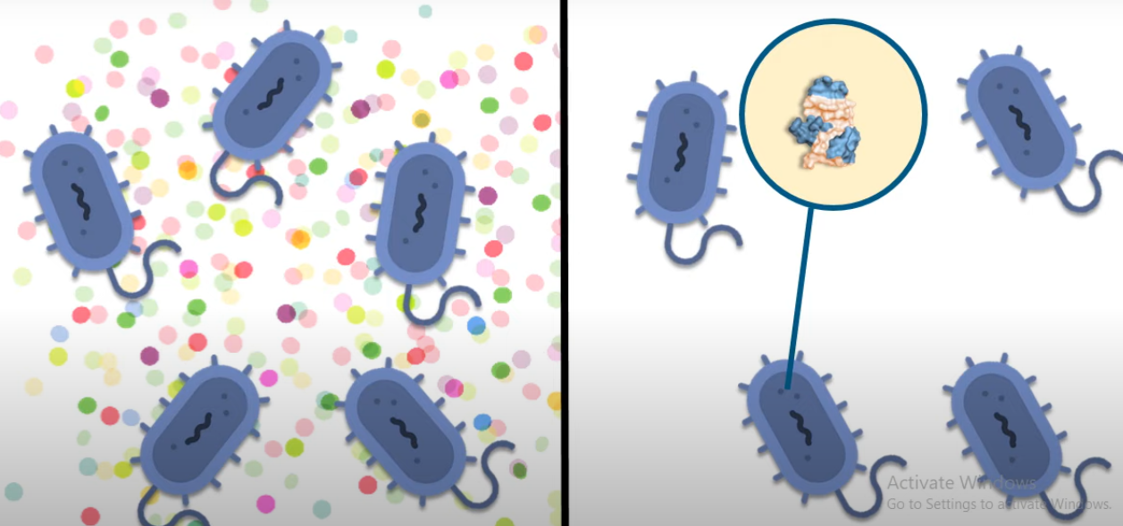
Downstream processing
Downstream processing is a method in which the product has been obtained from the bioreactor that has to be isolated and purified.
Extracellular
Intracellular

Slide 4
Cell Disruption
Disruption of microbial cells is to break the cells in order to release the contents of cells in the medium.
Cell disruption is an essential part of biotechnology and the downstream processes related to the manufacturing of biological products.
The disruption of cells is necessary for the extraction and retrieval of the desired products, as cell disruption significantly enhances the recovery of biological products.
Agitation, Ultrasonication
Chemicals and Enzymes
Solvents

Slide 5
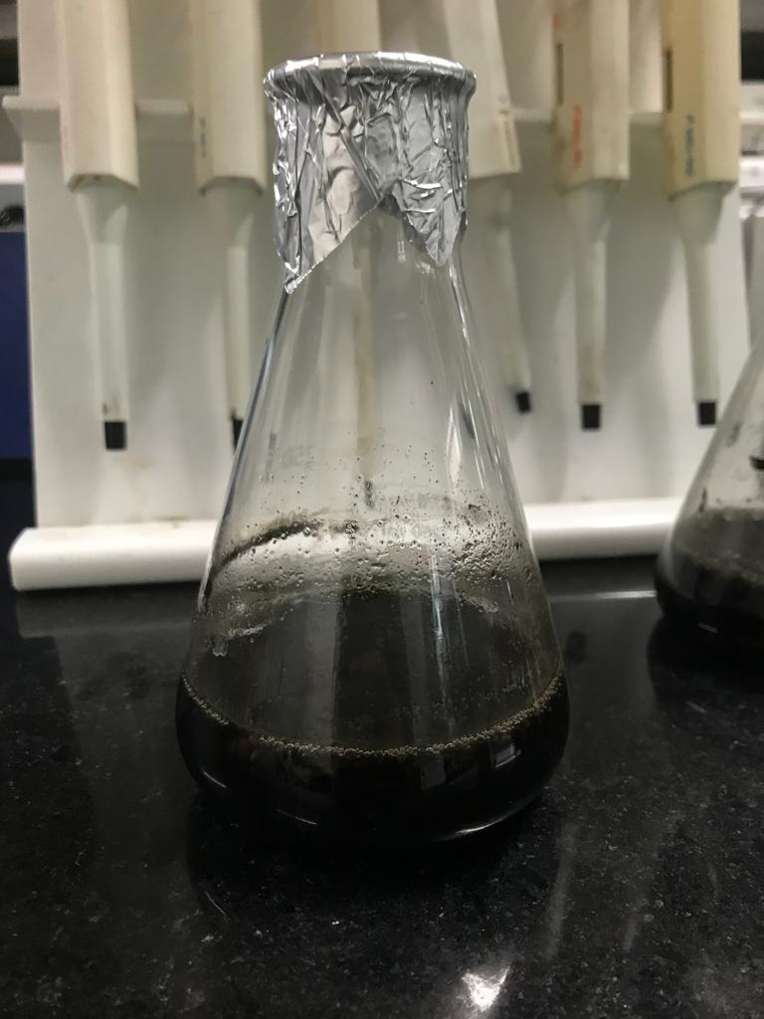
Extraction
Extraction is the process of recovering a compound or a group of compounds from a mixture or from cells into a solvent phase.

Slide 6
Filtration
Filtration is the most commonly used technique for separating the biomass and culture filtrate.
The mixture goes through a filter which retains the particulates according to size while allows the passage of fluid through the filter
It is used at various stages of the downstream processing in the bioreactor harvest as well as processing of purified products
The efficiency of the filtration depends on many factors such as the size of the organism, presence of other organisms, viscosity of the medium, and temperature
Most common filtration techniques are microfiltration and ultrafiltration

Slide 7
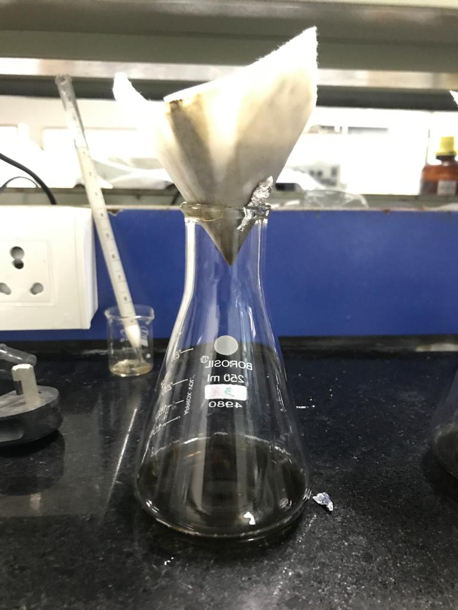
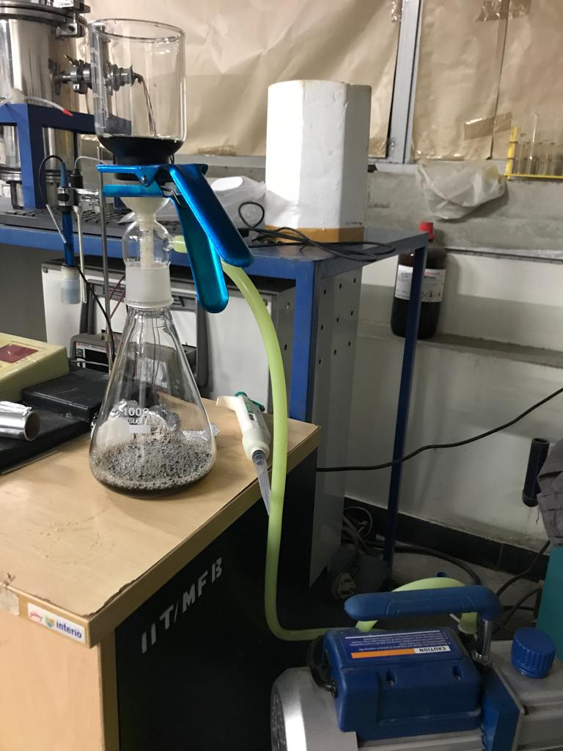

Slide 8
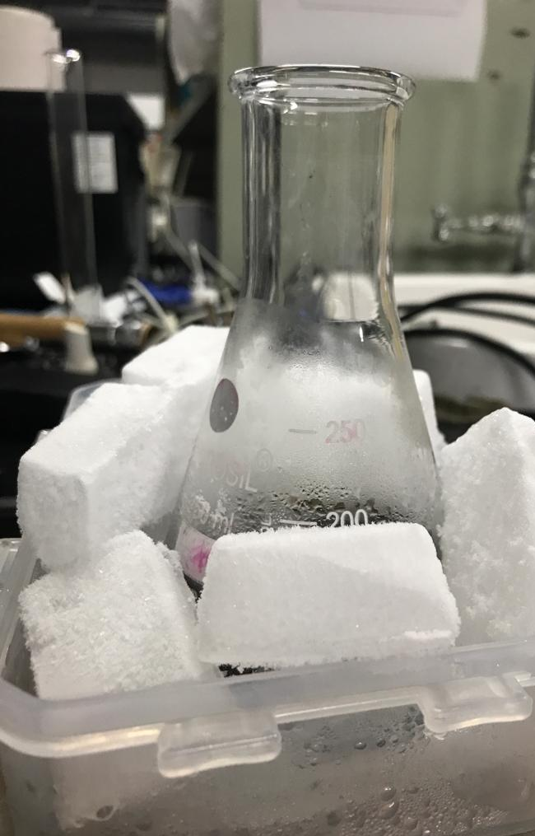
Precipitation
Formation of a solid in a solution during a chemical reaction called precipitation
Solid formed is called the precipitate and the liquid remaining above the solid is called the supernatant.
It is the most commonly used technique in industry for the concentration of macromolecules.
It can also be employed for the removal of certain unwanted by-products.
Precipitation of protein is widely used in downstream processing in order to concentrate proteins and purify them from various contaminants or other proteins.

Slide 9
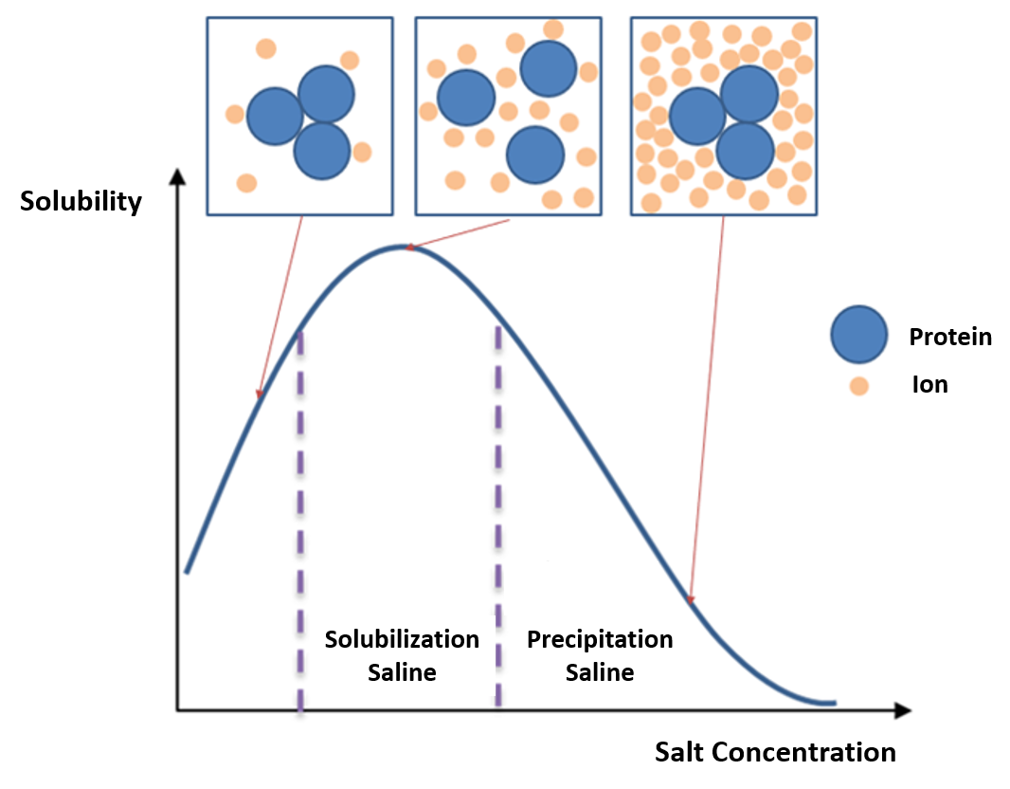
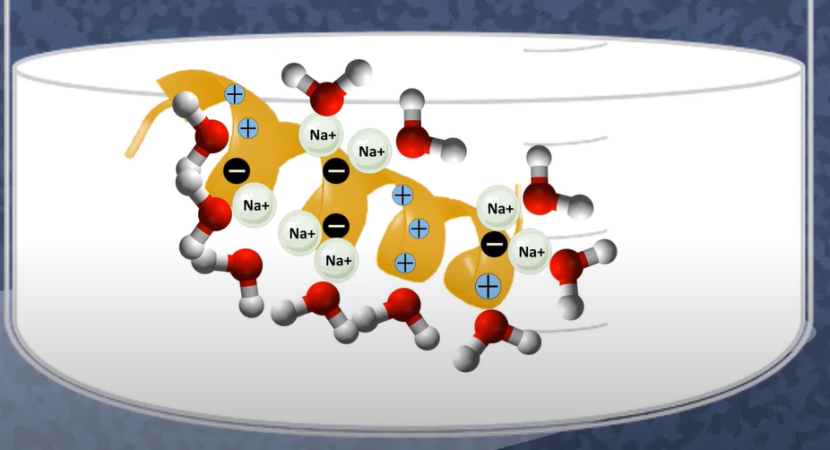
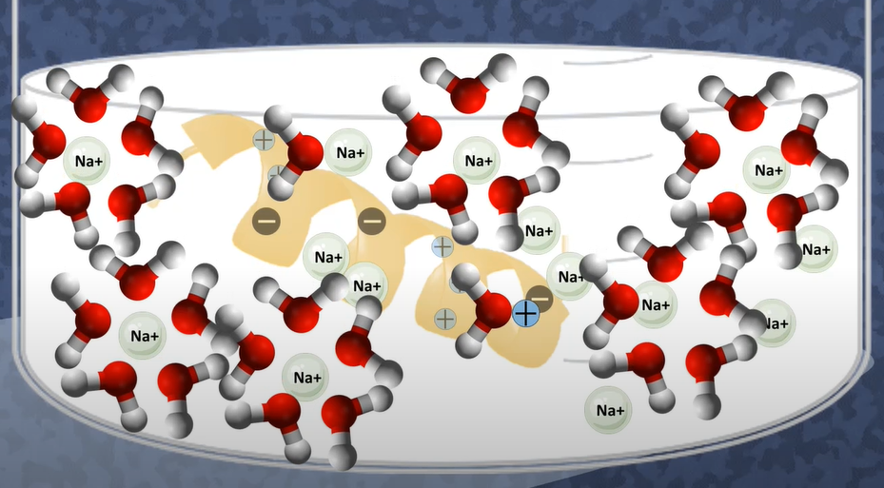
Salting in and salting out
Salting in: increasing ionic strength of a solution increases the solubility of a solute
Salting out: very high salt concentration, decrease in solubility and precipitation
Salting in
Salting out

Slide 10
Centrifugation
Most effective when the particles to be separated are large, the liquid viscosity is low and the density difference between particles and fluid is great.
Batch centrifuge is common in the labs but the low processing capacity limits its use in large scale.
Continuous centrifuges are common in large scale processing in which the deposited solids are removed continuously or intermittently.

Slide 11
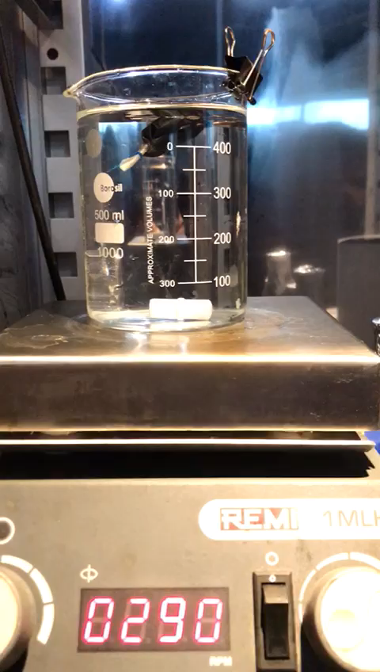
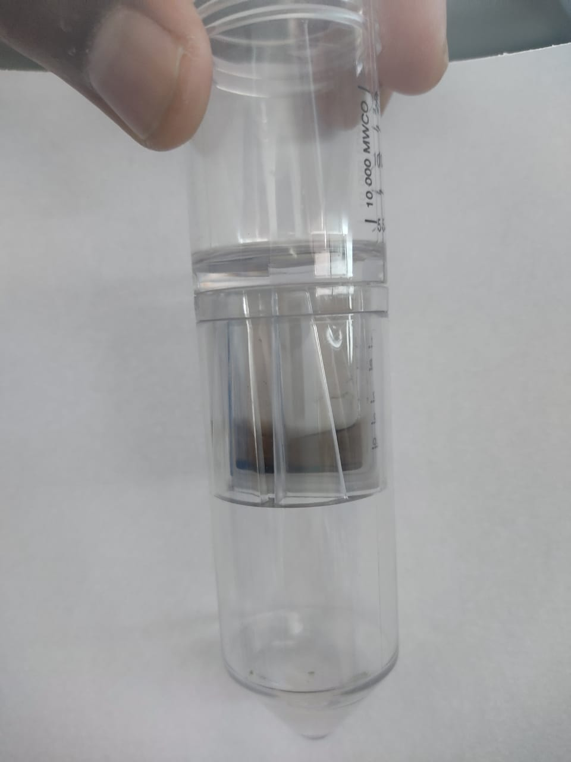
Dialysis
The obtained pellet from centrifuge will be suspended in the buffer.
The suspended protein is loaded in a dialysis membrane with specified molecular weight cut off.
Dialysis will be done against large quantity of buffer.

Slide 12
Chromatography
Chromatography is an analytical technique commonly used for separation of a mixture of chemical substances into its individual components, so that the individual components can be thoroughly analyzed.
The mixture is dissolved in a fluid called the mobile phase. Which carries it through a structure holding another material called the stationary phase.
Chromatography is used to effectively purify the biological products.
There are many types of chromatography e.g. liquid, gas, ion-exchange, affinity chromatography. All of these employ the same basic principles.

Slide 13
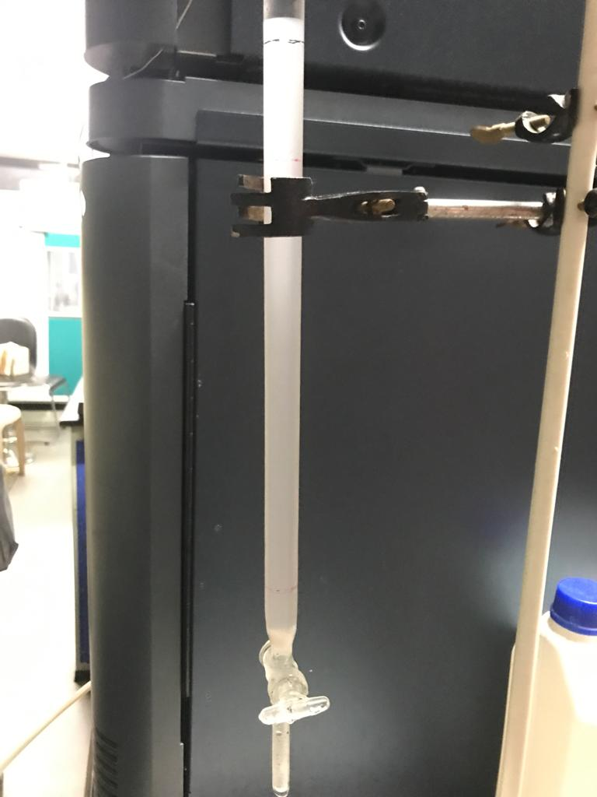
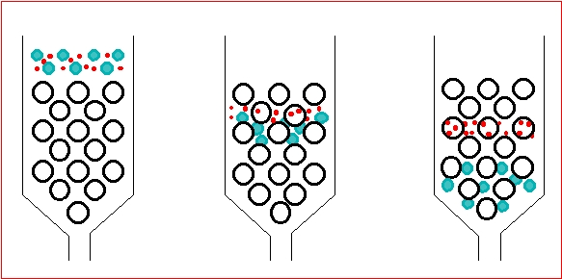
Gel filtration chromatography

Slide 14
Chromatography principle
It is based on the principle of separation of compounds into different bands and then identification of those bands.
Chromatography Principle
Gel-filtration size and shape
Ion exchange net charge
Affinity biological affinity and molecular recognition
Hydrophobic interaction polarity

Slide 15
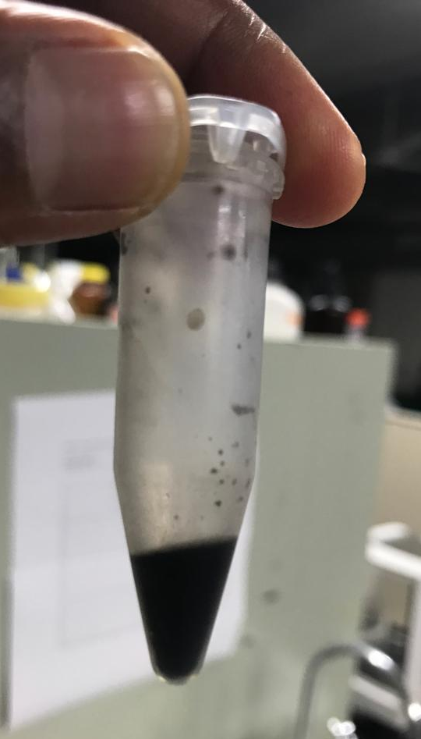
Lyophilization
Lyophilization is based on a simple principle of physics called “sublimation”
Sublimation is the process of transition of a substrate from solid to the vapor state without passing through an intermediate liquid phase.
The material to be dried is first frozen and then subjected under a high vacuum to heat so that frozen liquid sublimes leaving only solid, dried components of the original liquid.

Slide 16
Steps involved in lyophilization
Freezing: the product is frozen. This provides a necessary condition for low temperature
Vacuum: after freezing, the product is placed under vacuum. This enables the frozen solvent in the product to vaporize without passing through liquid phase.
Heat: Heat is applied to the frozen product to accelerate sublimation.
Condensation: Low temperature condenser plates remove the vaporized solvent from the vacuum chamber by converting it back to a solid. This completes the separation process.

Slide 17
Applications
Pharmaceutical and Biotechnology
Pharmaceutical companies often use freeze-drying to increase the shelf life of products such as vaccines and other injectables.
By removing the water from the material and sealing the material in a vial, the material can be easily stored and shipped.
Food Industry
Preserve food and make it very light weight
The process has been popularized in the forms of freeze dried ice cream. And example of astronaut food
Technological Industry
In bio separations, freeze drying can be used also as a large stage purification procedure , because it can effectively remove solvents

Slide 18
Thank You

Slide 19
Questions ?

